Slide 1
3D Game Basic
6th class
Unity3D – 2D Animation
Handityo aulia putra

Slide 2
Information [important]
Most of the images in the steps of the projects are GIF (not images)
You should play the GIF either by using a GIF player or run the slideshow of the PPT

Slide 3
Overview
We will cover:
Flipping a sprite horizontally
Animating body parts for character movement events
Creating a 3-frame animation clip to make a platform continually animate
Making a platform start falling once stepped-on using a Trigger to move animation from one state to another
Creating animation clips from sprite sheet sequences

Slide 4
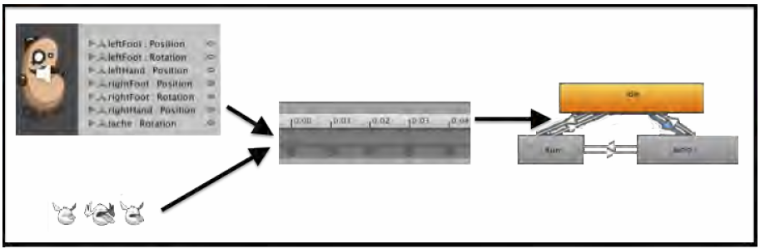
Overview
In Unity 2D animations can be created in several different ways –
One way is to create many images, each slightly different, which frame-by-frame give the appearance of movement.
A second way to create animations is by defining keyframe positions for individual parts of an object (for example, the arms, legs, feet, head, eyes, and so on), and getting Unity to calculate all the in-between positions when the game in running.

Slide 5
Overview
Both sources of animations become Animation Clips in the Animation panel.
Each Animation Clip then becomes a State in the Animator Controller State Machine.
We then define under what conditions a GameObject will Transition from one animation state (clip) to another.

Slide 6
Project submission

Slide 7
Project submission
There will be 3 different projects to submit
1st project:
Flipping a sprite horizontally
2nd project:
Animating body parts for character movement events
Creating a 3-frame animation clip to make a platform continually animate
Making a platform start falling once stepped-on using a Trigger to move animation from one state to another
3rd project:
Creating animation clips from sprite sheet sequences

Slide 8
Project submission
For each 1st , 2nd, and 3rd project, make the *.package file of unity (don’t forget to include all necessary assets)
Compress the three package files into a single file (.rar or .zip or .7z)
Upload it to ctl.kmu.ac.kr

Slide 9
2D Animation
Flipping a sprite horizontally
Animating body parts for character movement events
Creating a 3-frame animation clip to make a platform continually animate
Making a platform start falling once stepped-on using a Trigger to move animation from one state to another
Creating animation clips from sprite sheet sequences

Slide 10

Flipping a sprite horizontally

Slide 11
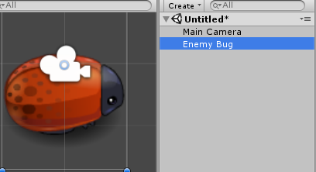
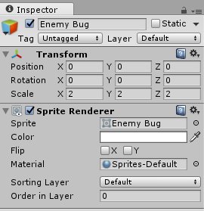
Flipping a sprite horizontally
1. Create a new Unity 2D project.
2. Import the provided image EnemyBug.png.
3. Drag an instance of the red Enemy Bug into the scene. Position this GameObject at (0, 0, 0) and scale to (2, 2, 2).

Slide 12
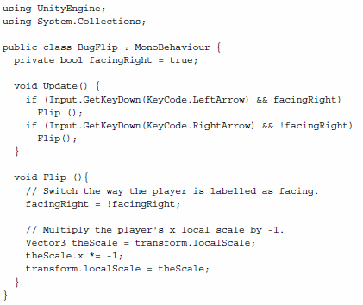

Flipping a sprite horizontally
4. Add an instance of C# script class BugFlip as a component to Enemy Bug GameObject:
5. When you run your scene, pressing the Left and Right arrow keys should make the bug face left or right correspondingly.

Slide 13
BugFlip.cs
using UnityEngine;
using System.Collections;
public class BugFlip : MonoBehaviour {
private bool facingRight = true;
void Update() {
if (Input.GetKeyDown(KeyCode.LeftArrow) && facingRight)
Flip ();
if (Input.GetKeyDown(KeyCode.RightArrow) && !facingRight)
Flip();
}
void Flip (){
// Switch the way the player is labelled as facing.
facingRight = !facingRight;
// Multiply the player's x local scale by -1.
Vector3 theScale = transform.localScale;
theScale.x *= -1;
transform.localScale = theScale;
}
}

Slide 14
BugFlip.cs
Method Update(), every frame,
checks to see if the Left or Right arrow keys have been pressed.
If the Left arrow key is pressed and the bug is facing right, then method Flip() is called, likewise
if the Right arrow key is pressed and the bug is facing left (that is, facing right is false), again method Flip() is called.

Slide 15
BugFlip.cs
Method Flip() performs two actions,
the first simply reverses the true/false value in variable facingRight.
The second action changes the +/- sign of the X-value of the localScale property of the transform.
Reversing the sign of the localScale results in the 2D flip.

Slide 16
2D Animation
Flipping a sprite horizontally
Animating body parts for character movement events
Creating a 3-frame animation clip to make a platform continually animate
Making a platform start falling once stepped-on using a Trigger to move animation from one state to another
Creating animation clips from sprite sheet sequences

Slide 17
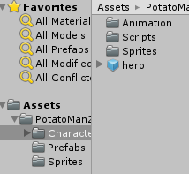
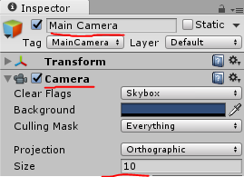
Animating body parts for character movement events
1. Create a new Unity 2D project.
2. Import the provided package BeanManAssets, by choosing menu: Assets | Import Package | Custom Package …, and then click the Import button to import all these assets into your Project panel.
3. Increase the size of the Main Camera to 10.

Slide 18
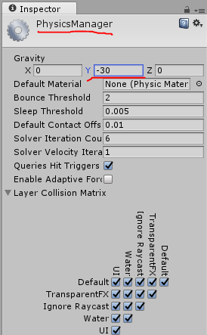
Animating body parts for character movement events
4. Setup the 2D gravity setting for this project - Y= -30.
Set 2D gravity to this value by choosing menu: Edit | Project Settings | Physics 2D, and then at the top change the Y value to -30.

Slide 19
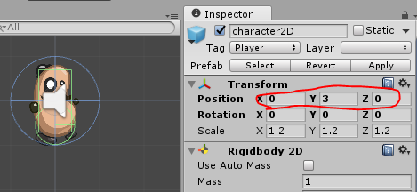
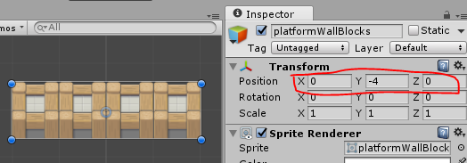
Animating body parts for character movement events
5. Drag an instance of the BeanMan character2D from the Project | Prefabs folder into the scene. Position this GameObject at (0, 3, 0).
6. Drag an instance of the sprite platformWallBlocks from the Project | Sprites folder into the scene. Position this GameObject at (0, -4, 0).

Slide 20
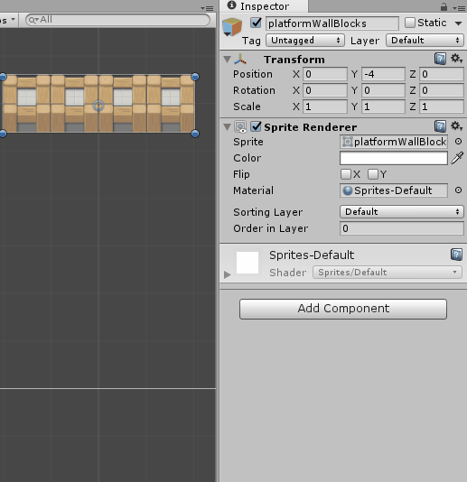
Animating body parts for character movement events
7. Add a Box Collider 2D component to GameObject platformWallBlocks by choosing menu: Add Component | Physics 2D | Box Collider 2D.

Slide 21
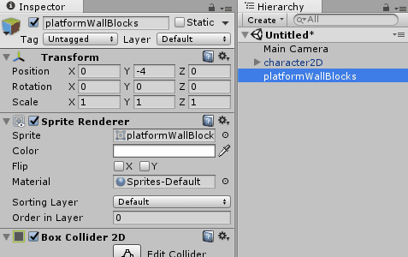
Animating body parts for character movement events
8. Create a new Layer named Ground, and assign GameObject platformWallBlocks to this new layer, as shown in the following screenshot.
Pressing the Space key when the character is on the platform will now make him jump.

Slide 22
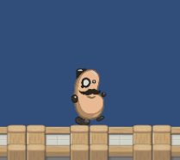
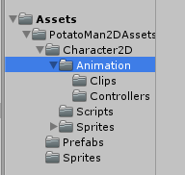
Animating body parts for character movement events
9. Currently the BeanMan character is animated (arms and legs moving) when we make him jump.
Let's remove the Animation clips and Animator controller and create our own from scratch.
Delete folders Clips and Controllers from Project | Assets | PotatoMan2DAssets | Character2D | Animation, as shown:

Slide 23
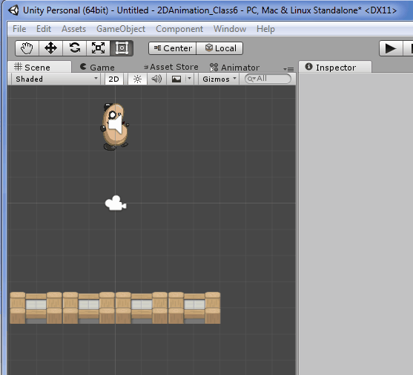
Animating body parts for character movement events
10. Let's create an Animation clip.
In the Hierarchy panel select GameObject hero.
Ensuring GameObject character2D is selected in the Hierarchy, open the Animation panel, and ensure it is in Dope Sheet view (this is the default).

Slide 24
Animating body parts for character movement events
11. Choose menu item [Create New Clip]:
12. Save the new clip in the Character2D | Animation folder, naming it as characterbeanman-idle.
You've now created an Animation clip for the 'idle' character state (which is not animated).

Slide 25
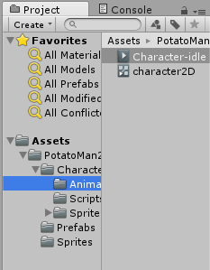
Animating body parts for character movement events
13. Looking at the Character2D | Animation folder in the Project panel you should now see both the Animation clip you have just created (character-beanman-idle) and also a new Animator controller, which has defaulted to the name of your GameObject character2D:

Slide 26
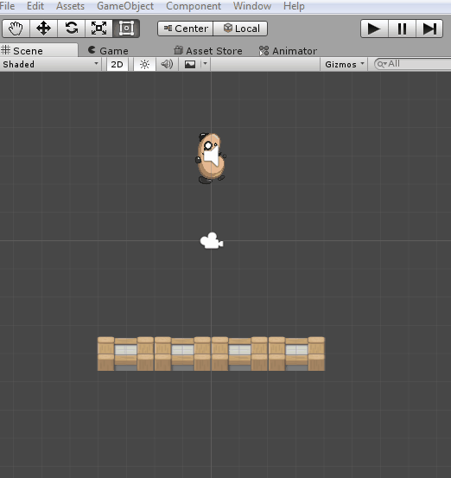
Animating body parts for character movement events
14. Ensuring GameObject character2D is selected in the Hierarchy, open the Animator panel and you'll see the State Machine for controlling the animation of our character.
Since we only have one Animation clip (character-beanman-idle) then upon entry the State Machine immediately enters this state.

Slide 27
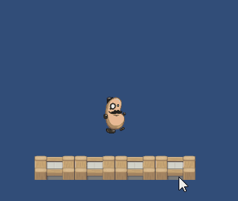
Animating body parts for character movement events
15. Run your scene – since the character is always in the 'idle' state, we see no animation yet when we make it jump.

Slide 28
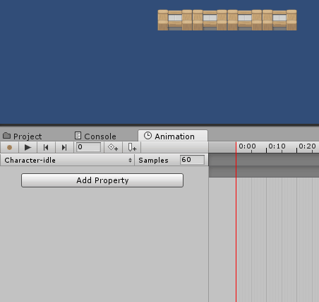
Animating body parts for character movement events
16. Now we'll create a 'jump' Animation clip which animates the hat.
Click the empty dropdown menu in the Animation panel (next to the greyed out word 'Samples'), and create a new clip in your Animation folder, naming it character-beanman-jump.

Slide 29
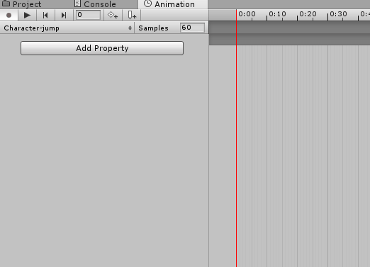
Animating body parts for character movement events
17. Click button Add Property, and choose Transform | Position of the hat child object, by clicking its '+' plus-sign button.
We are now recording changes to the (X, Y, Z) position of GameObject hat in this animation clip:

Slide 30
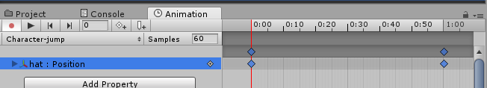
Animating body parts for character movement events
18. You should now see 2 'keyframes' at 0.0 and at 1.0.
These are indicated by diamonds in the Timeline area in the right-hand-section of the Animation panel.

Slide 31
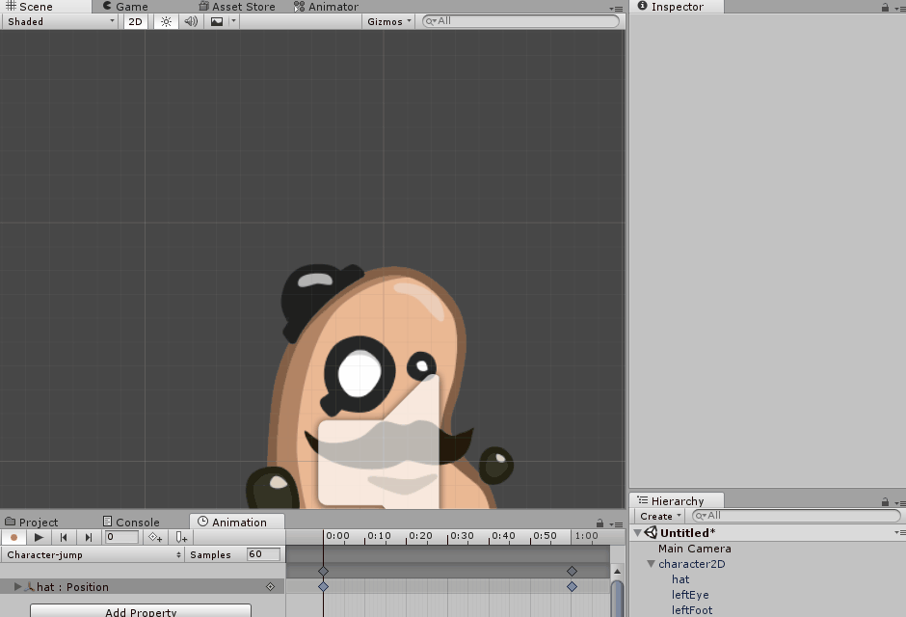
Animating body parts for character movement events
19. Click to select the first keyframe (at time 0.0).
Now in the Scene panel move the hat up and left a little, away from the head.
You should see that all three X, Y, Z values have a red background in the Inspector – this is to inform you that the values of the Transform component are being recorded in the animation clip:

Slide 32
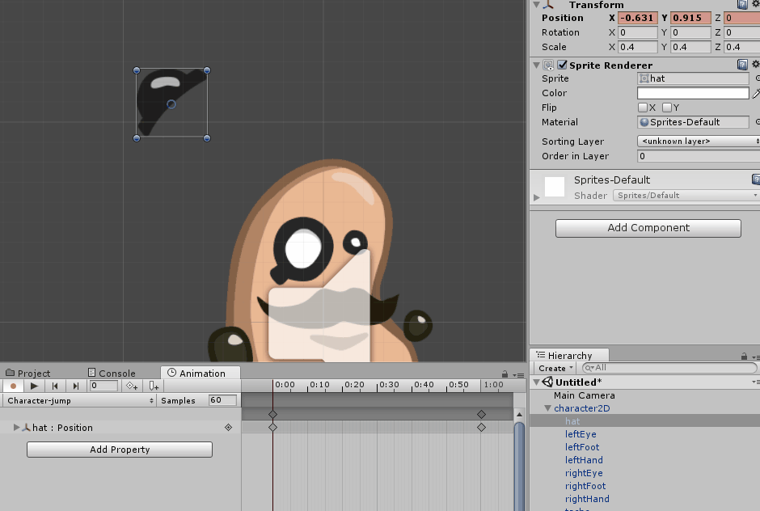
Animating body parts for character movement events
20. Since 1 second is perhaps too long for our jump animation, drag the second keyframe diamond to the left to a time of 0.5.

Slide 33
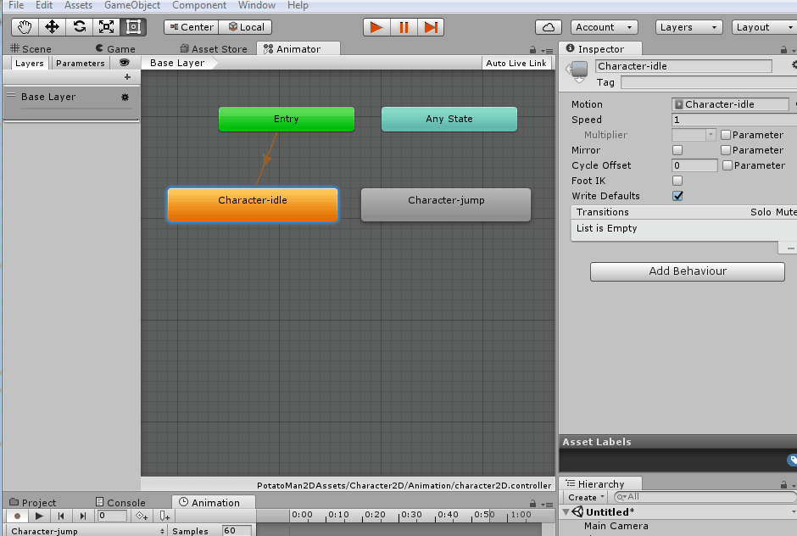
Animating body parts for character movement events
21. We now need to define when the character should Transition from the 'idle' state to the 'jump' state.
In the Animator panel select state character-beanman-idle, and create a transition to the state character-beanman-jump by right-mouse-clicking and choosing menu Make Transition, then drag the transition arrow to state characterbeanman-jump, as shown:

Slide 34
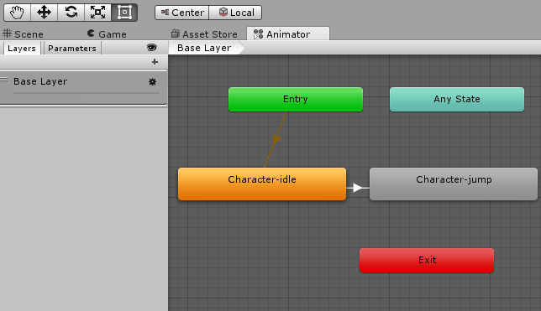
Animating body parts for character movement events
22. Now let's add a Trigger parameter named 'Jump', by clicking on the add parameter plus-sign "+" button at the top-left of the Animator panel, choosing Trigger, and typing the name Jump:

Slide 35
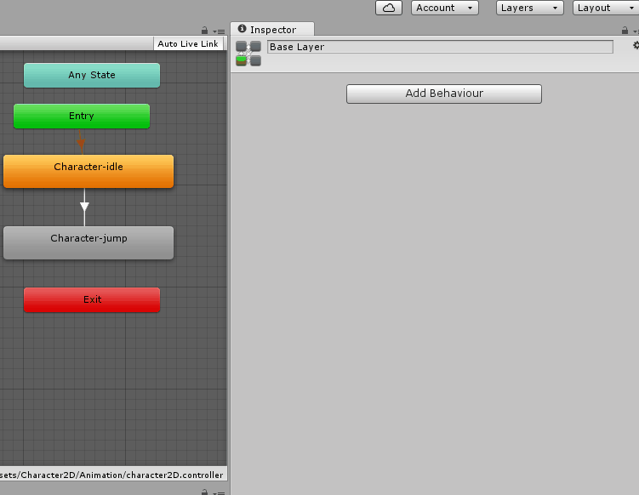
Animating body parts for character movement events
23. Define the properties for when our character should Transition from idle to jump. Click the Transition arrow to select it, and set the following 4 properties in the Inspector panel:
Has Exit Time: uncheck
Transition Duration: 0.01
Interruption State: Current State
Conditions: Add Jump (click plus-sign '+' button at bottom)

Slide 36
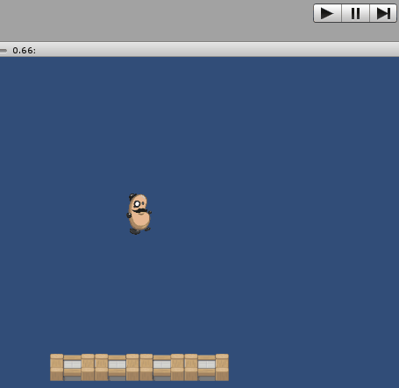
Animating body parts for character movement events
24. Save and run your scene.
Once the character has landed on the platform and you press the SPACE key to jump, you'll now see the character's hat jump away from his head, and slowly move back.
Since we haven't added any transition to ever leave the Jump state, this Animation clip will loop, so the hat keeps on moving even when the jump is completed.

Slide 37
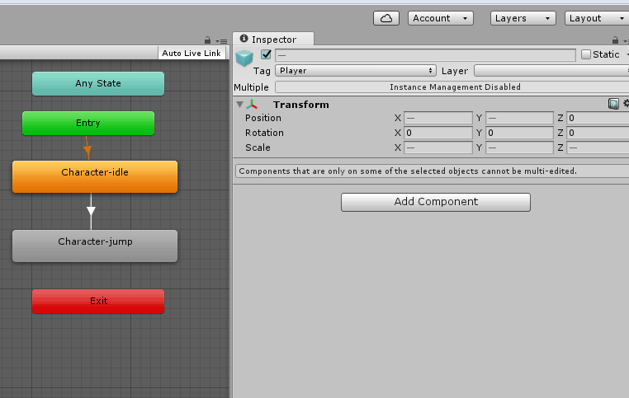
Animating body parts for character movement events
25. In the Animator panel select state character-beanman-jump and add a new Transition back to state character-beanman-idle. Select this Transition arrow and in the Inspector panel sets its properties as follows:
Has Exit Time: (leave as checked)
Exit time: 0.5 (this needs to be the same time value as the second keyfame of our Jump animation clip)
Transition Duration: 0.01
Interruption State: Current State

Slide 38
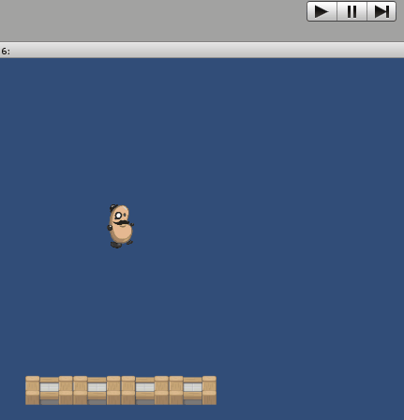
Animating body parts for character movement events
26. Save and run your scene. Now when you jump the hat should animate once, after which the character immediately returns to its Idle state.

Slide 39
Animating body parts for character movement events
We have added an Animation controller State Machine to GameObject character2D.
The Animation clips that we created (idle and jump) appear as States in the Animator panel.
We created a Transition from Idle to Jump when the 'Jump' Trigger parameter is received by the State Machine.
We created a second Transition, which transitions back to the Idle state after waiting 0.5 seconds (the same duration between the 2 keyframes in our Jump Animation clip).

Slide 40
Animating body parts for character movement events
Note that
the key to everything working for the bean-man character is that when we make the character jump with the SPACE key, then code in the PlayerControl C# scripted component of GameObject character2D, as well as making the sprite move upwards on screen, also sends a SetTrigger(…) message to the Animator controller component, for the Trigger named Jump.

Slide 41
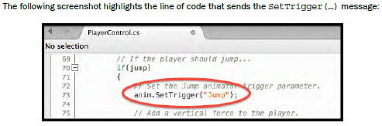
Animating body parts for character movement events
Note that
the key to everything working for the bean-man character is that when we make the character jump with the SPACE key, then the code in the PlayerControl C# scripted component of GameObject character2D, as well as making the sprite move upwards on screen, also sends a SetTrigger(…) message to the Animator controller component, for the Trigger named Jump.

Slide 42
2D Animation
Flipping a sprite horizontally
Animating body parts for character movement events
Creating a 3-frame animation clip to make a platform continually animate
Making a platform start falling once stepped-on using a Trigger to move animation from one state to another
Creating animation clips from sprite sheet sequences

Slide 43
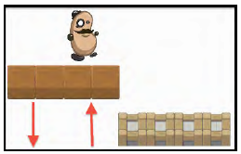
Creating a 3-frame animation clip to make a platform continually animate
In this project, we'll make a wooden-looking platform continually animate, moving upwards and downwards.
This can be achieved with a single, 3-frame, animation clip (starting at top, position at bottom, top position again).

Slide 44
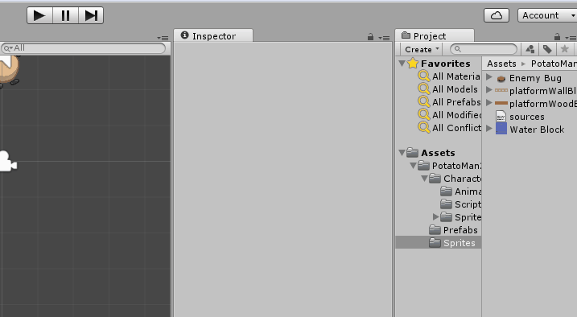
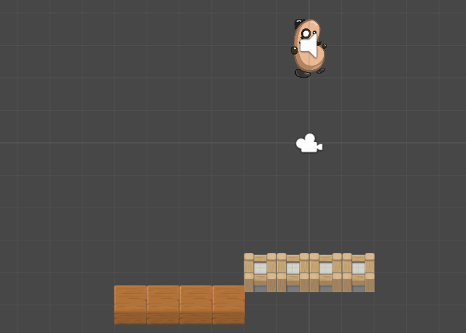
Creating a 3-frame animation clip to make a platform continually animate
1. Drag an instance of the sprite platformWoodBlocks from the Project | Sprites folder into the scene.
Position this GameObject at (-4, -5, 0), so that these wood blocks are neatly to left, and slightly below, the wall blocks platform.

Slide 45
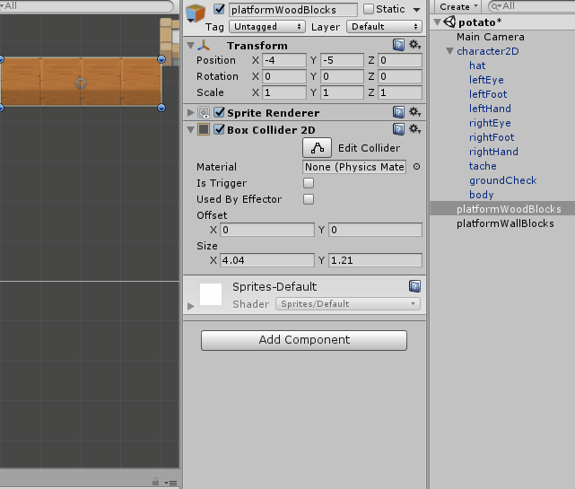
Creating a 3-frame animation clip to make a platform continually animate
2. Add a Box Collider 2D component to GameObject platformWoodBlocks so that the player's character can stand on this platform too.
Choose menu: Add Component | Physics 2D | Box Collider 2D.

Slide 46
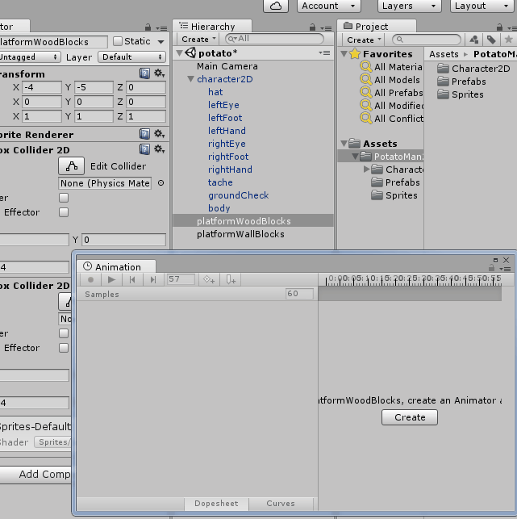
Creating a 3-frame animation clip to make a platform continually animate
3. Create a new folder named Animations, in which to store the animation clip and controller we'll create next.
4. Ensuring GameObject platformWoodBlocks is still selected in the Hierarchy, open an Animation panel, and ensure it is in Dope Sheet view (this is the default).

Slide 47
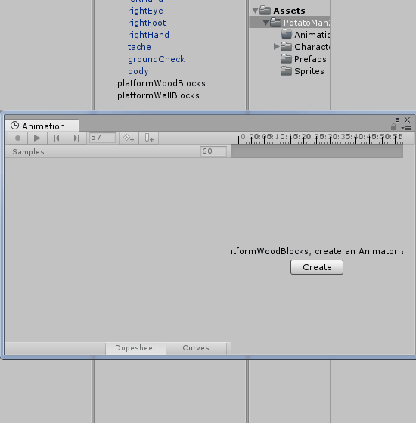
Creating a 3-frame animation clip to make a platform continually animate
5. Click the empty dropdown menu in the Animation panel (next to the greyed out word 'Samples'), and choose menu item [Create New Clip].
6. Save the new clip in your Animations folder, naming it 'platform-wood-moving-up-down'.

Slide 48
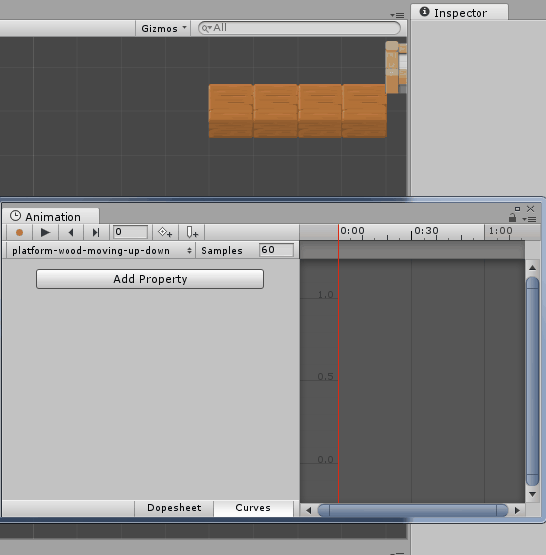
Creating a 3-frame animation clip to make a platform continually animate
7. Click button Add Curve, and chose Transform and the click the '+' plus-sign by Position.
Now record changes to the (X, Y, Z) position of GameObject platformWoodBlocks in this animation clip.

Slide 49
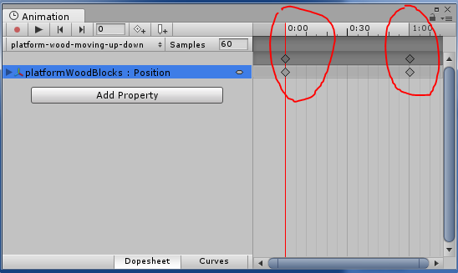
Creating a 3-frame animation clip to make a platform continually animate
8. You should now see 2 'keyframes' at 0.0 and at 1.0. These are indicated by diamonds in the Timeline area in the right-hand-section of the Animation panel.

Slide 50
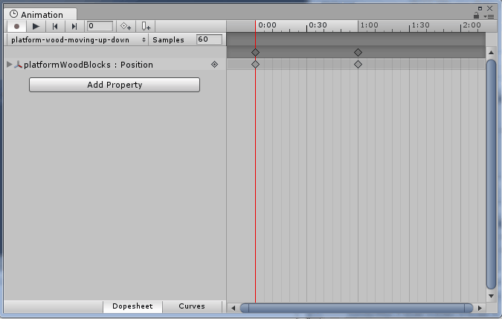
Creating a 3-frame animation clip to make a platform continually animate
9. We need 3 keyframes, with the new one at 2:00 seconds.
Click at 2:00 in the Timeline along the top of the Animation panel, so that the red line for the current playhead time is at time 2:00.
Then click diamond+ button to create a new keyframe at the current playhead time:

Slide 51
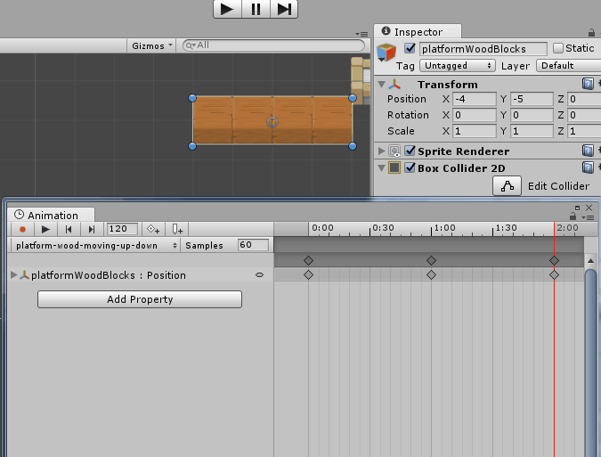
Creating a 3-frame animation clip to make a platform continually animate
10. The first and third keyframes are fine – they record the current height of the wood platform at Y= -5.
We need to make the middle keyframe record the height of the platform at the top of its motion.
Select the middle keyframe (at time 1:00), by clicking on either diamond at time 1:00 (they should both turn blue, and the red playhead vertical line should move to 1:00, to indicate the middle keyframe is being edited).

Slide 52
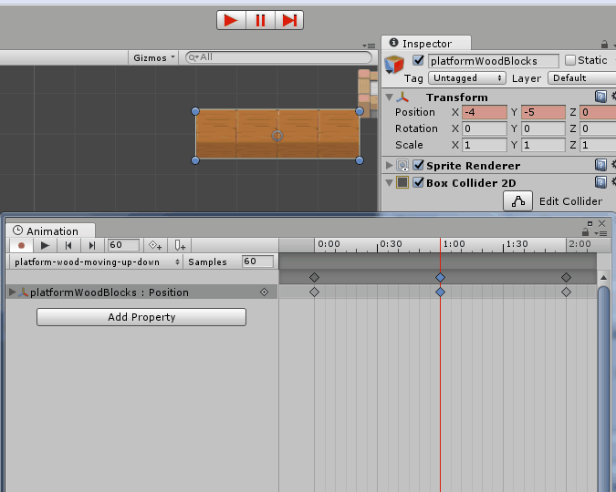
Creating a 3-frame animation clip to make a platform continually animate
11. Now in the Inspector change the Y position of the platform to 0.
You should see that all three X, Y, Z values have a red background in the Inspector – this is to inform you that the values of the Transform component are being recorded in the animation clip.

Slide 53
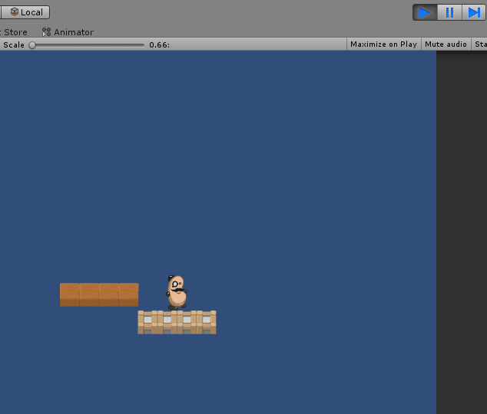
Creating a 3-frame animation clip to make a platform continually animate
12. Save and run your scene.
The wooden platform should now be animating continuously, moving smoothly up and down the positions we setup.

Slide 54
Creating a 3-frame animation clip to make a platform continually animate
We have added an animation to GameObject platformWoodBlocks.
This animation contains three keyframes.
A keyframe represents the values of properties of the object at a point in time.
The first keyframe stores a Y-value of -4,
the second keyframe a Y-value of 0, and
The final keyframe -4 again.
Unity calculates all the in-between values for us, and the result is a smooth animation of the Y-position of the platform.

Slide 55
Creating a 3-frame animation clip to make a platform continually animate
Note:
If we wanted to duplicate the moving platform,
first we'd need to create a new, empty GameObject named movingBlockParent, and then parent platformWoodBlocks to this GameObject.
Duplicating GameObject movingBlockParent would then allow us to create more moving blocks in our scene.

Slide 56
Creating a 3-frame animation clip to make a platform continually animate
If we simply duplicated platformWoodBlocks directly,
then when the scene runs each duplicate would be animated back to the location of the original animation frames
(that is, all copies would be positioned and moving in the original location).

Slide 57
2D Animation
Flipping a sprite horizontally
Animating body parts for character movement events
Creating a 3-frame animation clip to make a platform continually animate
Making a platform start falling once stepped-on using a Trigger to move animation from one state to another
Creating animation clips from sprite sheet sequences

Slide 58
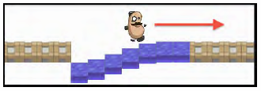
Making a platform start falling once stepped-on using a Trigger to move animation from one state to another

Slide 59
Making a platform start falling once stepped-on using a Trigger to move animation from one state to another
In this project:
we'll create a water platform block in our 2D platform game;
such blocks will begin to slowly fall down the screen as soon as they have been stepped on,
and so the player must keep on moving otherwise they'll fall down the screen with the blocks too!
It looks as shown in the following screenshot:

Slide 60
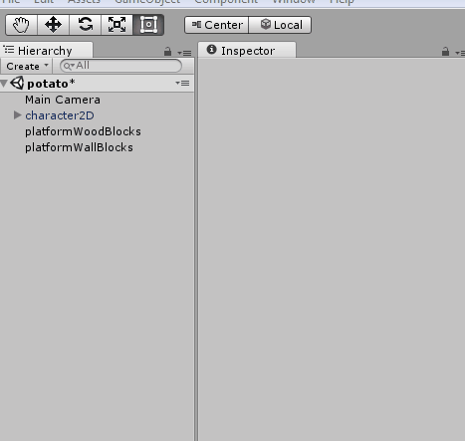
Making a platform start falling once stepped-on using a Trigger to move animation from one state to another
1. In the Hierarchy
create an Empty GameObject named water-block-container, positioned at (2.5, -4, 0).
This empty GameObject will allow us to make duplicates of animated Water Blocks that will animate relative to their parent GameObject position.

Slide 61
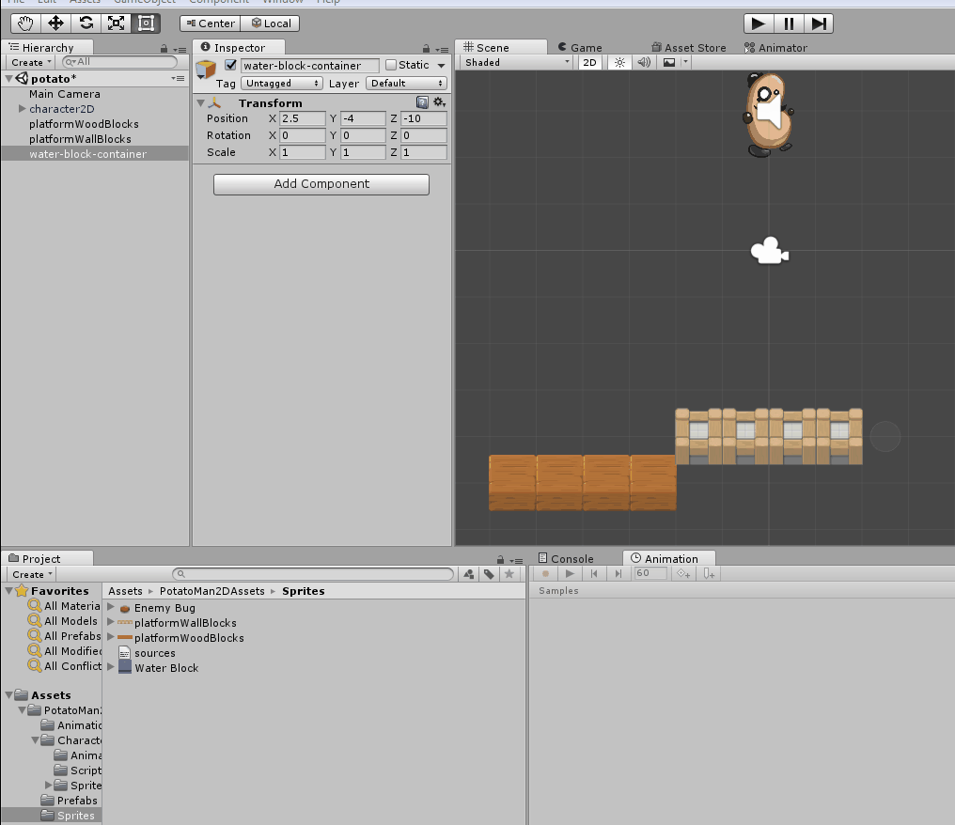
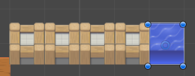
Making a platform start falling once stepped-on using a Trigger to move animation from one state to another
2. Drag an instance of the sprite Water Block from the Project | Sprites folder into the scene and child it to GameObject water-block-container.
Ensure the position of your new child GameObject Water Block is (0, 0, 0), so that it appears neatly to right of the wall blocks platform, as shown in the following screenshot:

Slide 62
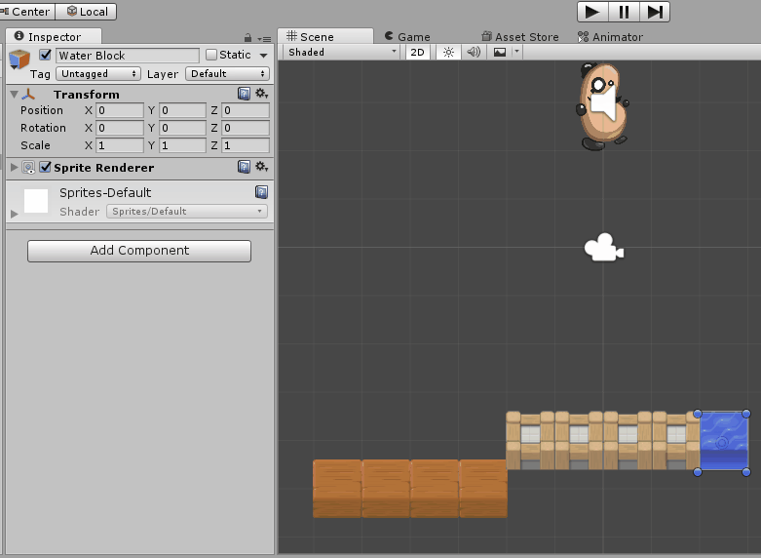
Making a platform start falling once stepped-on using a Trigger to move animation from one state to another
3. Add a Box Collider 2D component to child GameObject Water Block, and set the layer of this GameObject to Ground, so that the player's character can stand and jump on this water block platform.

Slide 63
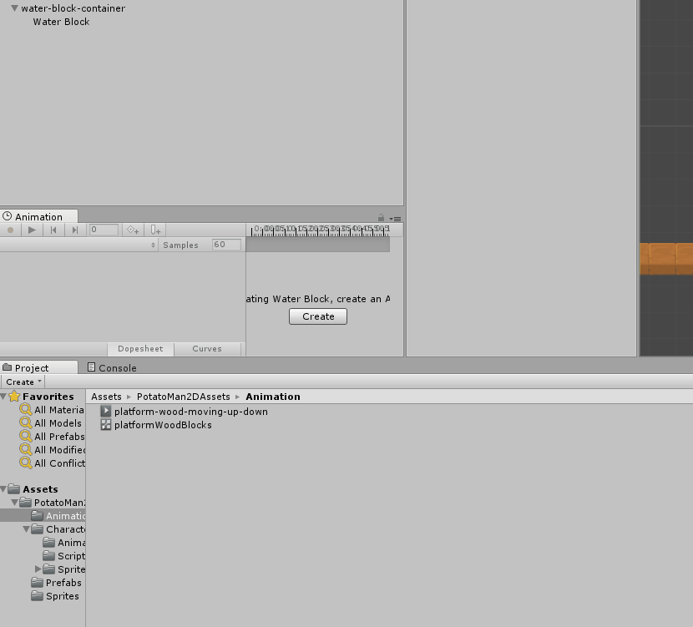
Making a platform start falling once stepped-on using a Trigger to move animation from one state to another
4. Ensuring child GameObject Water Block is selected in the Hierarchy, open an Animation panel, then create a new clip named platform-water-up. saving it in your Animations folder.

Slide 64
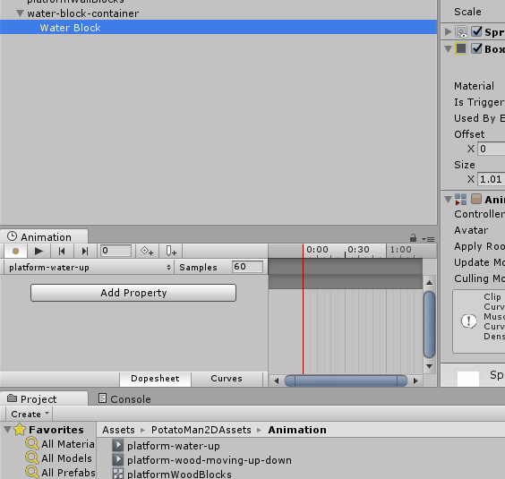
Making a platform start falling once stepped-on using a Trigger to move animation from one state to another
5. Click button Add Curve, and chose Transform and Position.
6. Delete the second keyframe at time 1:00.
You have now completed the creation of the water block up animation clip.

Slide 65
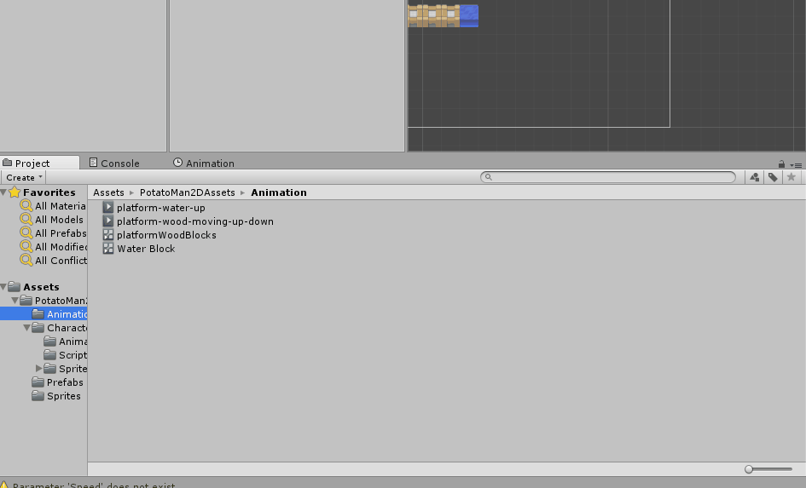
Making a platform start falling once stepped-on using a Trigger to move animation from one state to another
7. Create a second Animation clip, named platform-water-down.
Again, click button Add Curve, and chose Transform and Position, and delete the second keyframe at time 1:00.

Slide 66
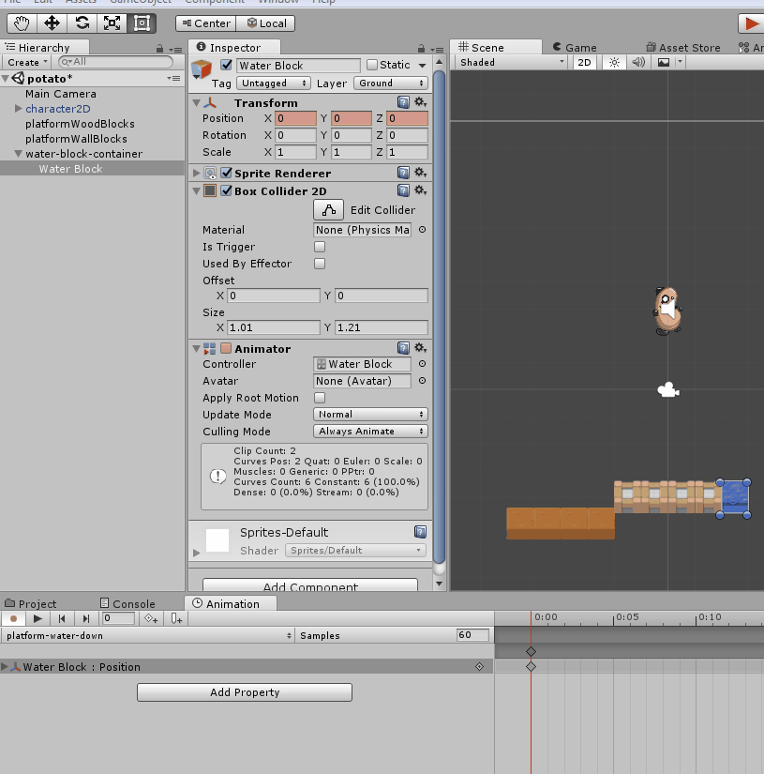
Making a platform start falling once stepped-on using a Trigger to move animation from one state to another
8. With the first keyframe at time 0:00 selected, set the Y-value of the GameObjects Transform Position to -5.
You have now completed the creation of the water block down animation clip, so you can click the red record button to stop recording.

Slide 67

Making a platform start falling once stepped-on using a Trigger to move animation from one state to another
9. You may have noticed that as well as the up/down Animation Clips that you created, another file was created in your Animations folder, an Animator Controller named Water Block.
Select this file and open the Animator panel, to see and edit the State Machine diagram:

Slide 68

Making a platform start falling once stepped-on using a Trigger to move animation from one state to another
10. Ensure state platform-water-up is selected
(it will have a blue border around it),
create a Transition (arrow) to state platform-water-down, by choosing Make Transition from the mouse-right-click menu.
Notes:
Currently, although we created 2 animation clips (states), only the Up state is ever
active. This is because when the scene begins (Entry) the object will immediately go
in state platform-water-up, but since there are no transition arrows from this state to
platform-water-down, then at present the Water Block GameObject will always be in
its Up state.

Slide 69

Making a platform start falling once stepped-on using a Trigger to move animation from one state to another
11. Create a Trigger named Fall, by choosing the Parameters tab in the Animator panel, clicking the plus '+' button and selecting Trigger, and then selecting Fall.
Notes:
Currently, although we created 2 animation clips (states), only the Up state is ever
active. This is because when the scene begins (Entry) the object will immediately go
in state platform-water-up, but since there are no transition arrows from this state to
platform-water-down, then at present the Water Block GameObject will always be in
its Up state.

Slide 70

Making a platform start falling once stepped-on using a Trigger to move animation from one state to another
12. Do the following to create our Trigger:
In the Animator panel select the Transition
In the Inspector panel uncheck the Has Exit Time option
In the Inspector panel drag the Transition end time to 2:00 seconds (so the Water Block slowly Transitions to its Down state over a period of 2 seconds)
In the Inspector panel click the plus '+' button to add a Condition, which should automatically suggest the only possible condition parameter, which is our Trigger Fall.
Notes:
Currently, although we created 2 animation clips (states), only the Up state is ever
active. This is because when the scene begins (Entry) the object will immediately go
in state platform-water-up, but since there are no transition arrows from this state to
platform-water-down, then at present the Water Block GameObject will always be in
its Up state.

Slide 71

Making a platform start falling once stepped-on using a Trigger to move animation from one state to another
13. We now need to add a collider trigger just above the Water Block, and add C# script behavior to send the Animator Controller Trigger when the player enters the collider.
Ensuring child GameObject Water Block is selected, add a (second) 2D Box Collider, with a Y-Offset of 1, and tick its Is Trigger checkbox:
Notes:
Currently, although we created 2 animation clips (states), only the Up state is ever
active. This is because when the scene begins (Entry) the object will immediately go
in state platform-water-up, but since there are no transition arrows from this state to
platform-water-down, then at present the Water Block GameObject will always be in
its Up state.

Slide 72

Making a platform start falling once stepped-on using a Trigger to move animation from one state to another
14. Add an instance of C# script class WaterBlock as a component to your Water Block child GameObject:
Notes:
Currently, although we created 2 animation clips (states), only the Up state is ever
active. This is because when the scene begins (Entry) the object will immediately go
in state platform-water-up, but since there are no transition arrows from this state to
platform-water-down, then at present the Water Block GameObject will always be in
its Up state.

Slide 73
WaterBlock.cs
using UnityEngine;
using System.Collections;
public class WaterBlock : MonoBehaviour {
private Animator animatorController;
void Start(){
animatorController = GetComponent<Animator>();
}
void OnTriggerEnter2D(Collider2D hit){
if(hit.CompareTag("Player")){
animatorController.SetTrigger("Fall");
}
}
}
Notes:
Currently, although we created 2 animation clips (states), only the Up state is ever
active. This is because when the scene begins (Entry) the object will immediately go
in state platform-water-up, but since there are no transition arrows from this state to
platform-water-down, then at present the Water Block GameObject will always be in
its Up state.

Slide 74

Making a platform start falling once stepped-on using a Trigger to move animation from one state to another
15. Make 6 more copies of GameObject water-block-container, with X positions increasing by 1 each time, that is, 3.5, 4.5, 5.5, and so on.
Notes:
Currently, although we created 2 animation clips (states), only the Up state is ever
active. This is because when the scene begins (Entry) the object will immediately go
in state platform-water-up, but since there are no transition arrows from this state to
platform-water-down, then at present the Water Block GameObject will always be in
its Up state.

Slide 75

Making a platform start falling once stepped-on using a Trigger to move animation from one state to another
Notes:
Currently, although we created 2 animation clips (states), only the Up state is ever
active. This is because when the scene begins (Entry) the object will immediately go
in state platform-water-up, but since there are no transition arrows from this state to
platform-water-down, then at present the Water Block GameObject will always be in
its Up state.

Slide 76
2D Animation
Flipping a sprite horizontally
Animating body parts for character movement events
Creating a 3-frame animation clip to make a platform continually animate
Making a platform start falling once stepped-on using a Trigger to move animation from one state to another
Creating animation clips from sprite sheet sequences

Slide 77

Creating animation clips from sprite sheet sequences

Slide 78
Creating animation clips from sprite sheet sequences
In this project, we'll import and break up an open source monster sprite sheet into three animation clips for
Idle,
Attack, and
Death

Slide 79

Creating animation clips from sprite sheet sequences
1. Create a new Unity 2D project.
2. Import the provided image monster1.
3. With image monster1 selected in the Project panel, change its Sprite mode to Multiple in the Inspector, then open the Sprite Editor panel by clicking button Sprite Editor.

Slide 80

Creating animation clips from sprite sheet sequences
4. In the Sprite Editor
open the Slice dropdown dialog,
set the Type to Grid, set the grid Pixel Size to 64x64, and then
click the Slice button.
Finally, click the Apply button in the bar at the top right of the Sprite Editor panel):

Slide 81

Creating animation clips from sprite sheet sequences
5. In the Project panel you can now click the expand triangle button center-right on the sprite, and you'll see all the different child frames for this sprite.

Slide 82

Creating animation clips from sprite sheet sequences
6. Create a folder named Animations.
7. In your new folder, create an Animator Controller named monster-animator.

Slide 83

Creating animation clips from sprite sheet sequences
8. In the scene
create a new Empty GameObject named monster1 (at position 0, 0, 0), and
drag your monster-animator into this GameObject.
9. With GameObject monster1 selected in the Hierarchy,
open up the Animation panel, and
create a new Animation Clip named Idle.

Slide 84

Creating animation clips from sprite sheet sequences
10. Select image monster1 in the Project panel (in its expanded view), and select and drag the first 5 frames (frames 0-4) into the Animation panel.
Change the sample rate to 12 (since this animation was created to run at 12-frames per second).

Slide 85

Creating animation clips from sprite sheet sequences
11. If you look at the State Chart for monster-animator, you'll see it has a default state (clip) named monster-idle.
12. When you run your scene you should now see the monster1 GameObject animating in its monster-idle state.

Slide 86
2D Animation Resources
Unity 2D Platformer (where the BeanMan character came from):
https://www.assetstore.unity3d.com/en/#!/content/11228
The platform sprites are from Daniel Cook's Planet Cute game resources:
http://www.lostgarden.com/2007/05/dancs-miraculously-flexiblegame.html
Creating a basic 2D platformer game:
https://www.unity3d.com/learn/tutorials/modules/beginner/livetraining-archive/creating-a-basic-platformer-game
Hat Catch 2D game tutorial:
https://www.unity3d.com/learn/tutorials/modules/beginner/livetraining-archive/2d-catch-game-pt1
Unity games from a 2D perspective video:
https://www.unity3d.com/learn/tutorials/modules/beginner/livetraining-archive/introduction-to-unity-via-2d
A fantastic set of modular 2D characters with a free Creative Commons license from 'Kenny'. These assets would be perfect for animating body parts in a similar way to the bean-man example in this chapter and in the Unity 2D platformer demo: http://kenney.nl/assets/modular-characters

Slide 87
For those who already have a good unity skills
Can do the following

Slide 88
Additional task
Only for those who want to have more challenge and think that the mini projects are too easy to follow
This can be a replacement for the mini projects
You either do only the mini projects or this project
There is a small 10% bonus point if you do both mini project and this one
This additional task will not have a step by step guide to help you
Submission method
Same with mini projects
Create a unity package file
Upload to ctl.kmu.ac.kr
If final file is bigger than 10MB, send me an email.

Slide 89
Additional task
Create a 2D side-scrolling platform game (megaman/Mario/etc):
You can use the assets provided for the mini-projects
You should make some falling platforms in the game
The character should have at least animation for idle, run, and jump
You should create a finish line / goal, thus when the character arrive at the goal, a big “GOAL” text will appear to tell the player that the game finished
Additional features:
At least have one item collection (can be anything from life, health, coins, or power ups), don’t forget to visualize the item collection either using text or icons
There is no limit on how long or short the platform is, but a reasonable length of playtime is required (at least 2 to 5 minutes)

Slide 90
Submission deadline
Saturday 20180929, 21:00 Korean time

